Slide 1
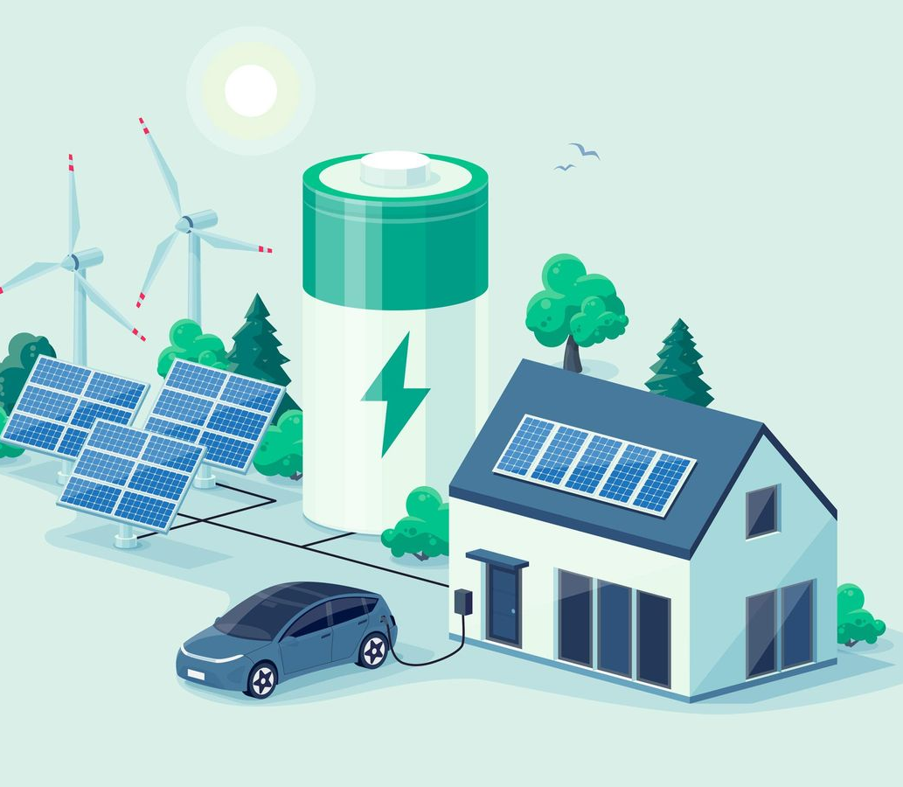
CIS-541-11: FUNDAMENT. OF BIG DATA ANALYT Instructor: Dr. Haitong Liao
Sergio Peres

Slide 2
How Big Data could help optimize and integrate the Renewable Energy Grid for electric vehicles?
Big data analytics can aid in the optimization and integration of renewable energy into the grid for electric vehicles by offering insights, predictions, and control mechanisms that enable more efficient, dependable, and sustainable energy consumption in the transportation sector.
This integration is critical for achieving a more sustainable and resilient energy ecology.

Slide 3
Scope
There are many participants, many processes, and a requirement for quick decision-making when it comes to the vast scope of optimizing and integrating renewable energy for car electrical.
By delivering insights, automation, and effective coordination of renewable energy sources and electric car charging, big data technologies, such as machine learning, data analytics, and IoT sensors, can assist in addressing these difficulties.
Big Data can help energy storage technologies, such as batteries and pumped hydro, operate more efficiently so that excess renewable energy can be stored when it's plentiful and released when it's needed. This contributes to the reliability and stability of the grid.

Slide 4
Benefactor
Operators can make sure that their charging stations have the facilities they require, such rapid charging options, safe payment alternatives, and dependable connectivity, by evaluating customer behavior and needs. Operators can increase income and efficiency while minimizing grid load by optimizing their pricing and service models.
General consumers benefit from a cleaner environment, lower energy costs, and access to EV charging infrastructure.
Through growing use of renewable energy sources and electric transportation, the environment gains from decreased greenhouse gas emissions and improved air quality. A cleaner and healthier living environment benefits society.

Slide 5
Purpose
Develop an energy environment that is more resilient, efficient, and sustainable. Utilizing cutting-edge technology and data analytics, this involves maximizing the potential of renewable energy sources while satisfying the rising demand for electric vehicles.
Operators and owners of EV charging stations can use data analytics to gain a better understanding of utilization trends, charging habits, and the general effectiveness of their infrastructure.
To build a more sustainable, effective, and resilient energy environment, the renewable energy grid for electric vehicles (EVs) is being optimized and integrated utilizing big data.

Slide 6
Background
Forecasting the production of renewable energy with accuracy
Large volumes of data from multiple sources, such as weather sensors, satellite images, and earlier records of energy output, may be collected and analyzed thanks to big data. By analyzing this data, we can create models that anticipate the production of renewable energy with greater accuracy. This increased accuracy can help with grid planning and management, which can lessen the requirement for fossil fuel backup power.
Big Data can identify the best locations to install charging infrastructure
Big Data can identify the ideal sites for EV charging stations by examining data on traffic patterns, population density, and EV adoption rates. This data-driven methodology makes sure that the positioning of the charging infrastructure is optimal to accommodate the rising demand for electric vehicles.

Slide 7
Python Analysis/Insights
Here are some analyses we may perform of the dataset “Eletric_Cars_World” and “Eletric_Cars_US:
The state of Washington (WA) has the highest quantity of electric cars in the US.
China, the US, and Germany were the top 3 nations in 2021 for investment and value in the electric vehicle market.
After performing a hypothesis test between these two columns: “Electric Vehicle (EV) Total” and “Battery Electric Vehicles (BEVs)”, the results indicated that there is a statistically significant difference of the means between those columns.

Slide 8
Conclusion
To sum up, utilizing big data to optimize and integrate the renewable energy grid for electric vehicles (EVs) has enormous promise for developing a more robust, effective, and sustainable energy ecosystem. To battle climate change, reduce air pollution, and ensure a cleaner, more sustainable future, it is crucial to combine renewable energy sources with the increasing use of EVs. As technology develops, there will be more opportunities to optimize and incorporate renewable energy into the grid for electric vehicles, providing a more promising and sustainable future for all of us.

Slide 9
References
https://www.statista.com/study/103895/electric-vehicles-report/
https://www.iea.org/data-and-statistics/data-tools/global-ev-data-explorer
https://www.lhpes.com/blog/how-data-analytics-enables-growth-for-ev-manufacturers
https://www.streetlightdata.com/4-ways-big-data-analytics-can-help-with-electric-vehicles-ev-charging-deployment/
https://energy5.com/the-role-of-data-analytics-in-optimizing-the-performance-and-usage-of-ev-charging-stations

